Slide 1
Enacting Distributed HPC Workflows: Opportunities and Challenges
Feb 20-21, 2025, UCR and UCI
Ketan Maheshwari
NCCS / OLCF, Oak Ridge National Laboratory

Slide 2
Acknowledgements
Profs. Tsotras, Eldawy, Roy Choudhury (UCR), Li (UCI), Jahangiri (SCU) for the invites and organization.
Thanks for the support at UCR: Gerardo and UCI: Jamie
The work presented here used resources of the Oak Ridge Leadership Computing Facility at the Oak Ridge National Laboratory, which is supported by the Office of Science of the U.S. Department of Energy under Contract No. DE-AC05-00OR22725
Thanks to colleagues at Oak Ridge and many collaborators who have contributed and enriched the work presented.

Slide 3
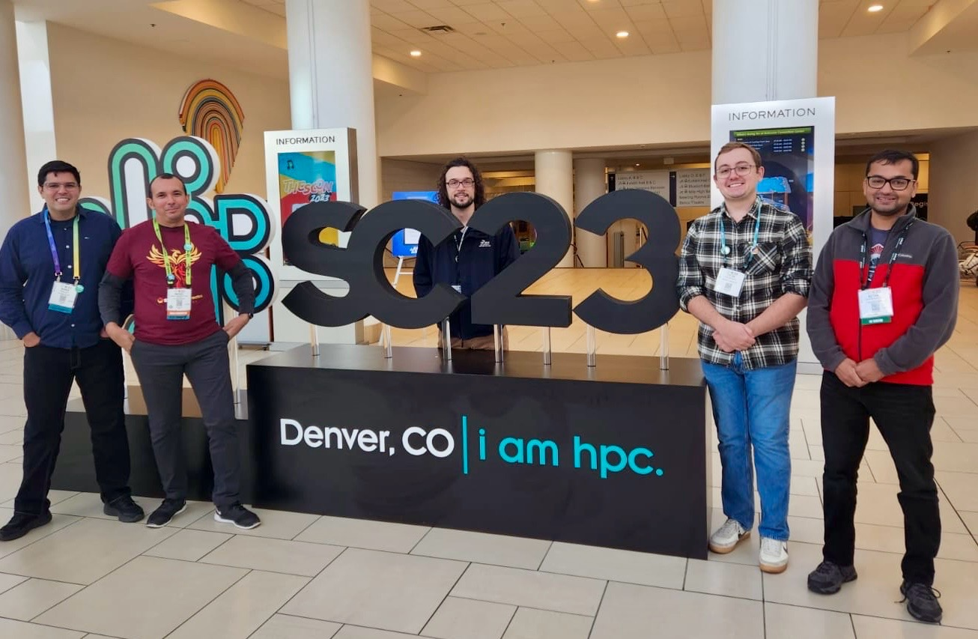
About me
Senior Engineer at Oak Ridge National Laboratory
Part of the NCCS Division / OLCF Program
Workflows and Ecosystem Services: Fast growing group of 9 as of 1/2025
Specialize in Science Workflows
Interested in HPC-Science applications, porting, deployment and troubleshooting aspects
Postdoc at Argonne National Laboratory and Cornell
PhD in Scientific Workflows area, Univ of Nice, France

Slide 4
Overview
Context: The DOE Complex
Workflows: What, Why, How, State of the art
The Various Aspects of Workflows
Representation and UI / UX
Data
Parallelism
Scheduling
Performance
Workflows Community
Distributed Workflows
Opportunities : Leveraging DOE Capacities and Capabilities
Challenges : Technical, Technological, Social / Cultural

Slide 5
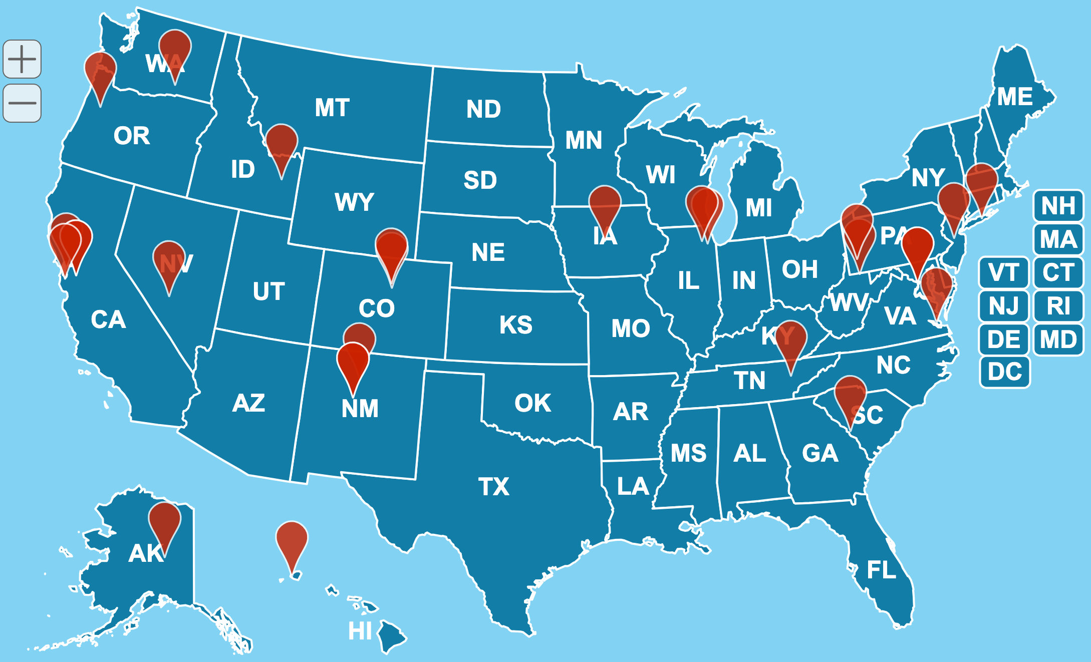
The Department of Energy (DOE) Complex: Seventeen Laboratories across the nation, a variety of Facilities
Geographically and administratively distributed
Data Producing Facilities such as APS, SNS
Data Producing Field Research such as Transportation and BioSciences research
Data Processing Facilities such as OLCF, ALCF, NERSC
Projects allocated to wider community including Universities and commercial entities
Science Workflows are of strategic importance for several programs spanning labs, eg. IRI
https://www.energy.gov/articles/map-explore-national-labs

Slide 6
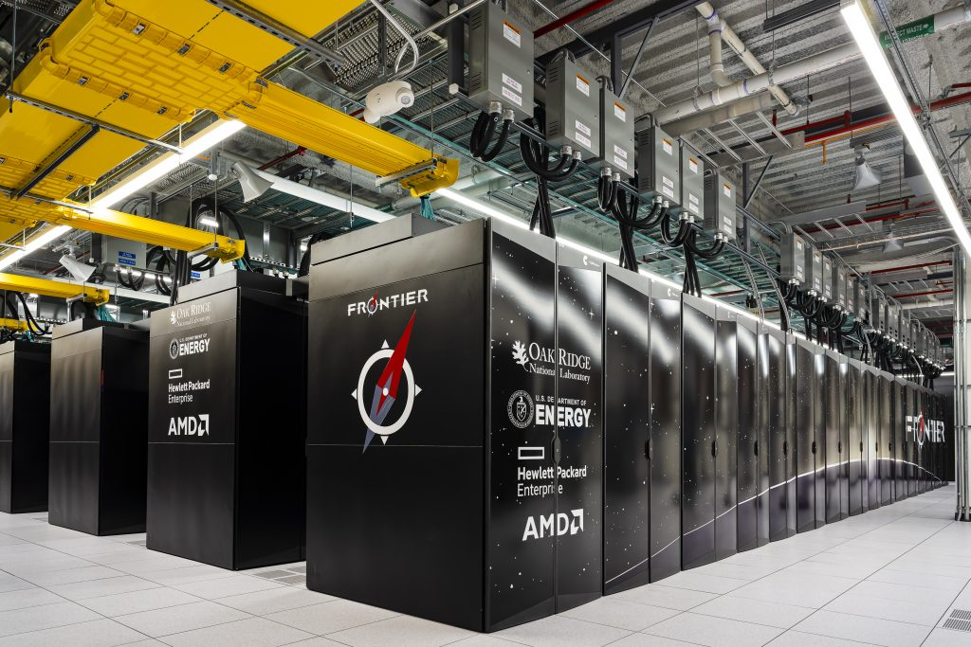
Oak Ridge Leadership Computing Facility (OLCF) is one of the Facilities providing Leadership class HPC Infrastructure
Frontier is the flagship supercomputer hosted at and managed by OLCF
Exascale (~1.7 ExaFLOP) system with over 9,400 compute nodes and a ~700 PB lustre based fast storage system
1 64-core AMD “Optimized 3rd Gen EPYC” CPU
4 AMD Instinct MI250X GPUs
4-port HPE Slingshot 200 Gbps (25 GB/s) NICs providing a node-injection bandwidth of 800 Gbps (100 GB/s)
Workflows are one of the priorities at OLCF for interdisciplinary science campaigns
https://www.olcf.ornl.gov/olcf-resources/compute-systems/frontier/

Slide 7
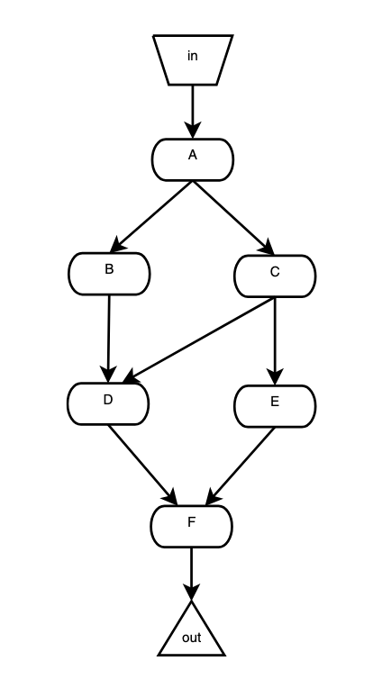
What are Workflows
Computations that are organized as multi-stage / multi-phase processes
Often represented as Directed Acyclic Graphs (DAG)
Have been called dataflows sometimes
Popular among computational science communities
Workflows automate a sequence of inter-dependent computational stages
docs.olcf.ornl.gov/software/workflows/index.html
K. Maheshwari and J. Montagnat, "Scientific Workflow Development Using Both Visual and Script Based Representation,"6th World Congress on Services, Miami, FL, 2010,

Slide 8
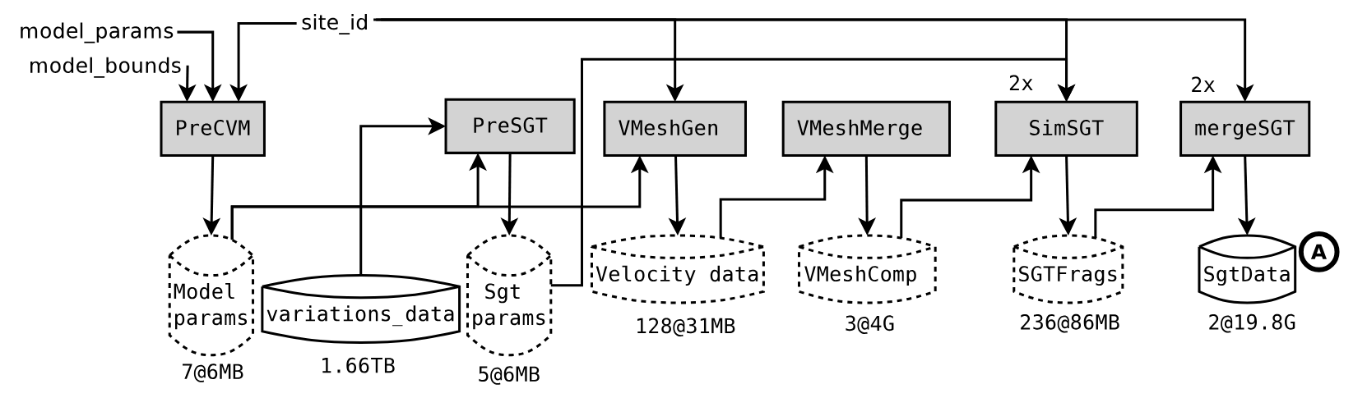
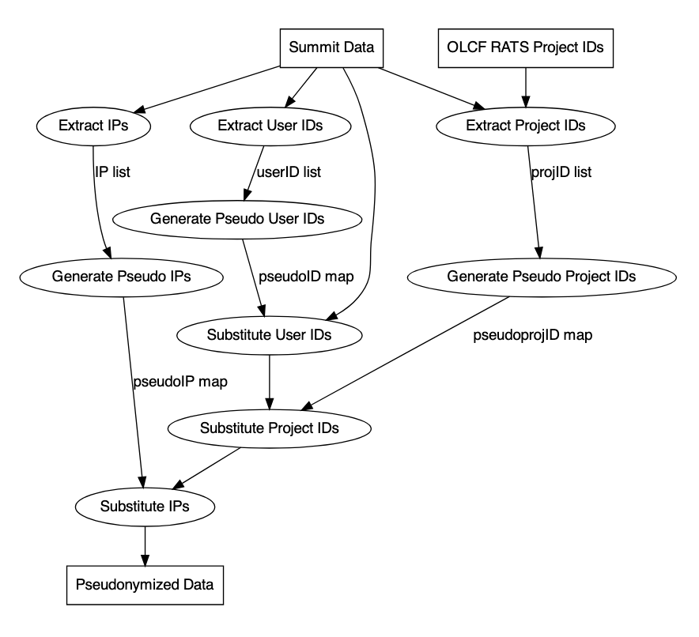
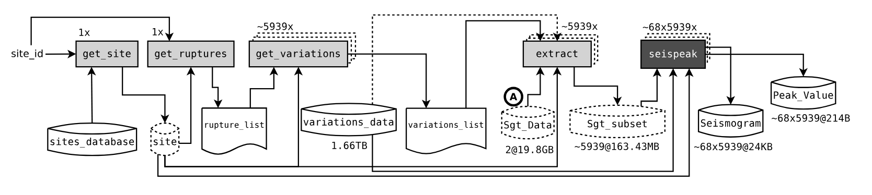
Illustrative Examples of Real-World Workflows
K. Maheshwari et al. "Pseudonymization at Scale: OLCF’s Summit Usage Data Case Study," 2022 IEEE International Conference on Big Data, Osaka, Japan, 2022, pp. 3432-3440, doi: 10.1109/BigData55660.2022.10020380. K. Maheshwari, A. Espinosa et al, 2012. Job and data clustering for aggregate use of multiple production cyberinfrastructures. In Proceedings of DIDC ‘12, ACM, New York, NY, USA, 3–12. https://doi.org/10.1145/2286996.2287000

Slide 9
Why are Workflows Required?
Manage complexity
Improve scientific practice
Automation avoids human errors
Workflows enable you to use the right tool for each task instead of writing one big, ugly program
Workflows enable automatic expert optimizations
Allocating and scheduling resources
Error handling and task restarting
Implicit parallelism
Fully automating an experiment enables
you to repeat the experiment easily with different or same conditions
others to reproduce your results from the exact same programs
others to reuse your computational methods for their own experiments so they don’t have to re-invent the wheel

Slide 10
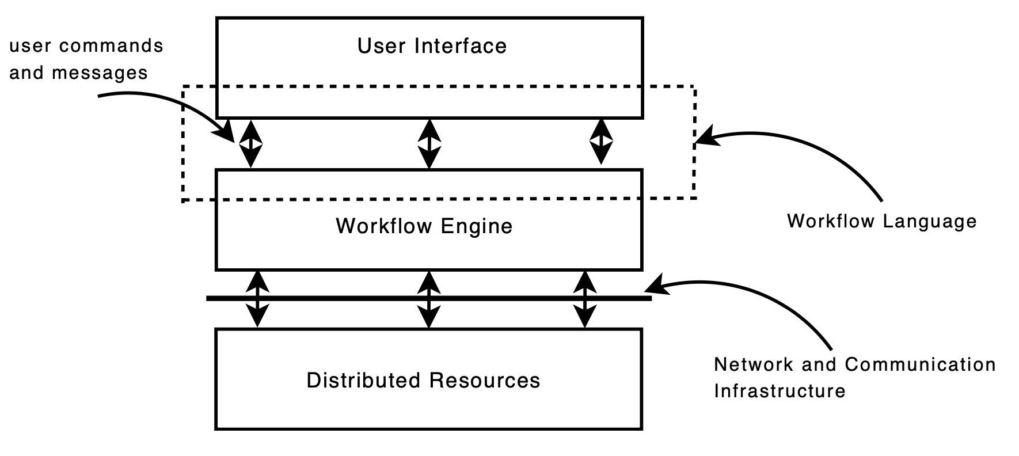
How: Workflow Management Systems
Software frameworks / packages
Facilitate Workflow Composition / Development
Automate optimal execution
Interface with computation resources
Hundreds of Workflow Systems available (358 as of Feb’25)*
Parsl, EnTK, Swift/T, Nextflow, Airflow, Dask, Snakemake are a few leading Workflow Management Systems
*github.com/common-workflow-language/common-workflow-language/wiki/Existing-Workflow-systems

Slide 11
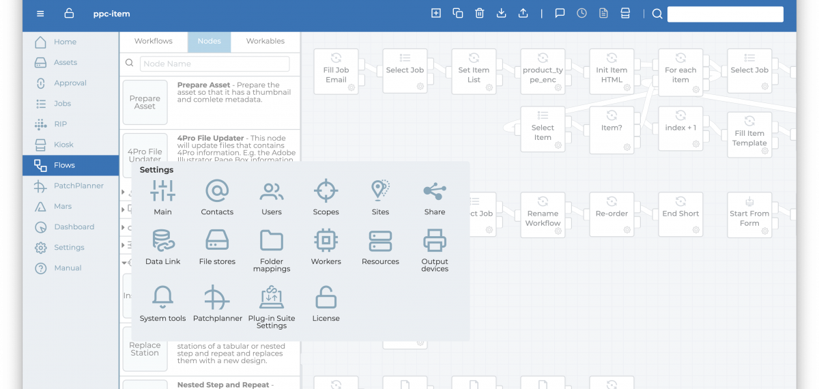
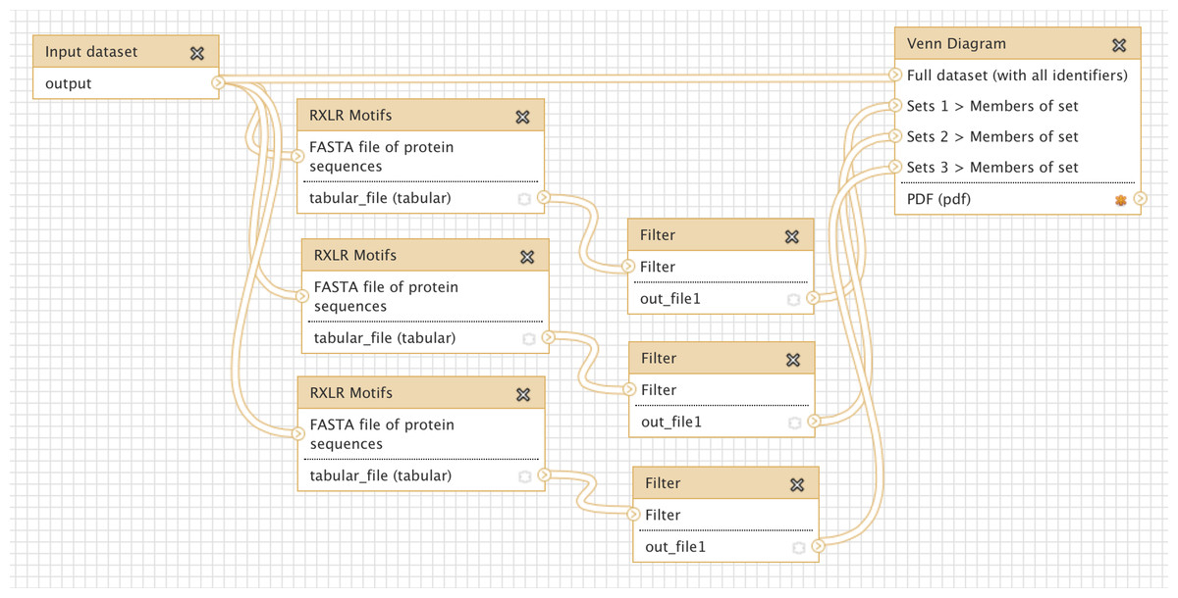
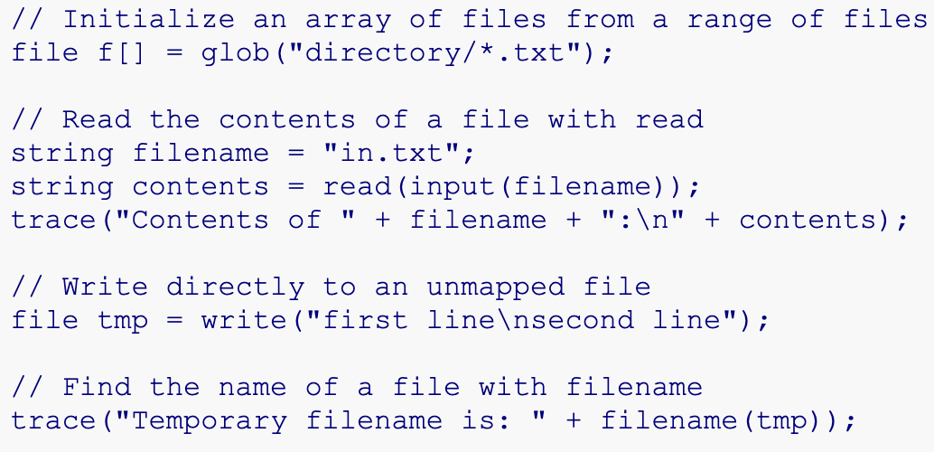
Workflow Management Systems: User Interface
Three kinds of user interfaces are common
Most workflow systems dominate in one of:
a web-based graphical interface such as Cloudflows
a standalone graphical user interface (GUI) such as Texera, Galaxy
a text-based programming-style interface such as Swift/T, Parsl, NextFlow
Most such systems provide templates and examples

Slide 12
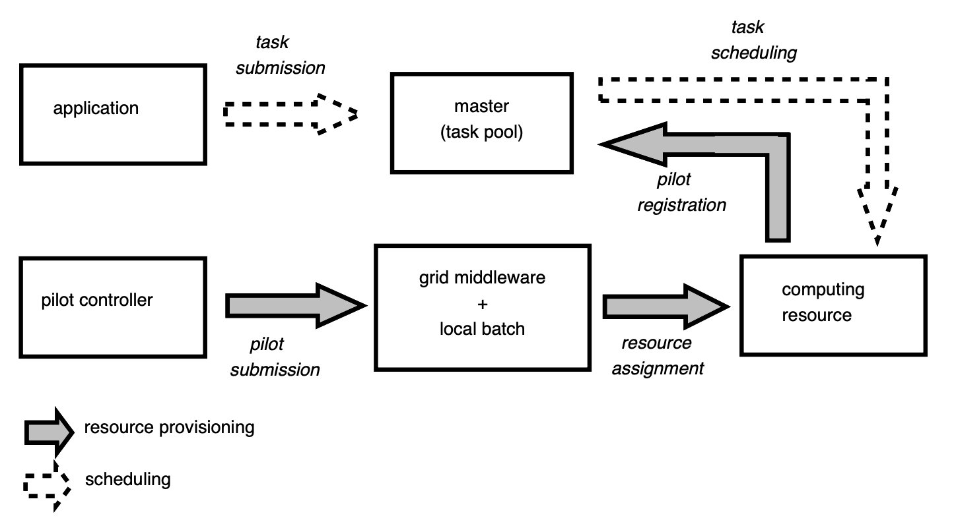
Workflow Management Systems: Task Scheduling
Automatic identification of data dependencies
Task grouping and Gang scheduling
Priority based scheduling
CPU vs GPU scheduling
Direct vs indirect interface with the job schedulers
Pilot job systems where a “server” process gets planted on a compute node and sets up an exchange to receive and run jobs from the workflow client
J. Montagnat et al. "Workflow-based comparison of two Distributed Computing
Infrastructures," The 5th Workshop on Workflows in Support of Large-Scale Science,
New Orleans, LA 2010 doi: 10.1109/WORKS.2010.5671856.

Slide 13
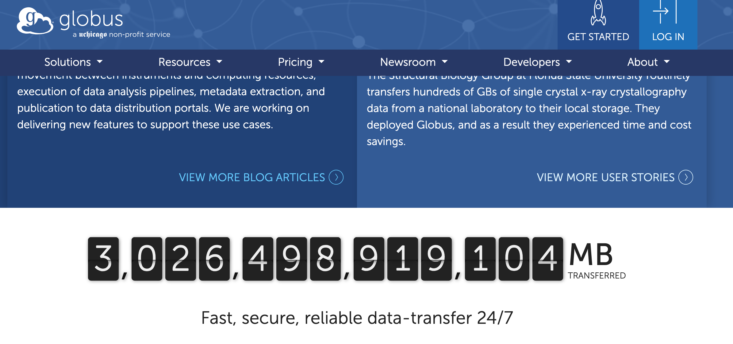
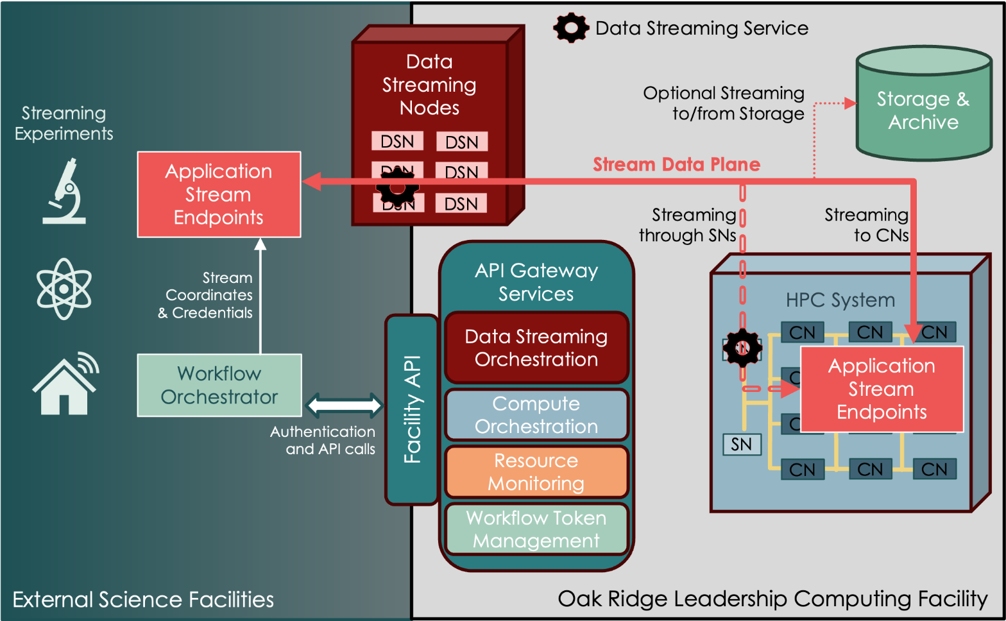
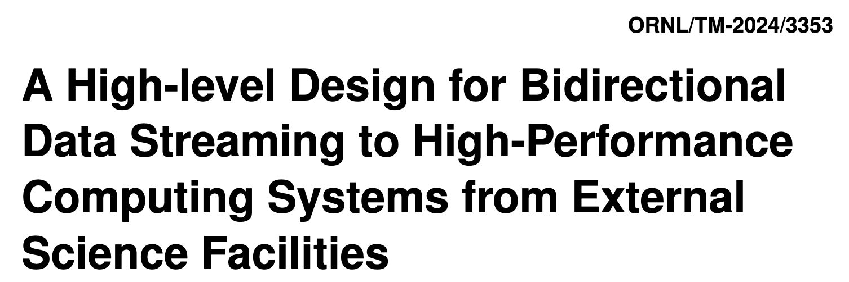
Workflow Management Systems: Data Handling
Streams vs Files vs Message Exchange Systems for Stage-in -> Compute -> Stage-out cycles
Auxiliary data such as logs and application traces
Globus is a leading platform for distributed data management via Oauth and agreements with institutions
Streaming data modality under active development as part of the IRI initiative at ORNL
https://doi.org/10.2172/2338264

Slide 14
“Last-Mile” Parallelization: How to run a bag-of-tasks flexibly, portably and efficiently?
MPI-based that is often built into applications such as NAMD, VASP, NWChem
Code integration libraries such as OpenMP
Some workflow systems provide MPI as task parallelization backbone
ad hoc via running processes in background over loops
Task based run-time parallelization such as GNU Parallel

Slide 15
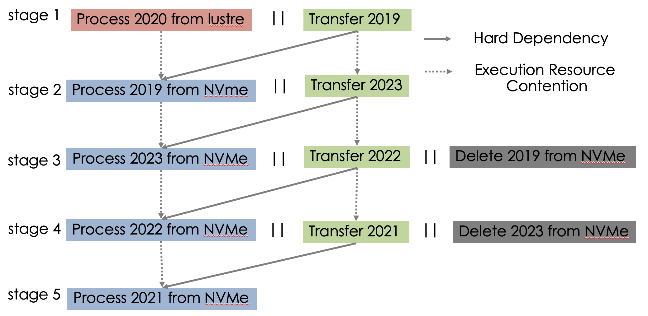
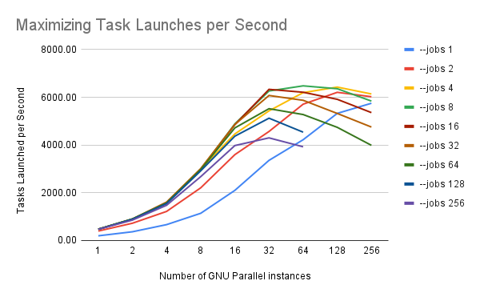
Exploration of GNU-Parallel as a Viable Parallelization for HPC Workflows on Frontier and Perlmutter
GNU Parallel integrates well within an HPC environment via simple shell scripts forming a viable and scalable tool to run tasks in parallel over HPC systems
K. Maheshwari et al, 2025. Enabling Low-Overhead HT-HPC Workflows at Extreme Scale using GNU Parallel. In Proceedings of the SC '24 Workshops (SC-W '24). doi.org/10.1109/SCW63240.2024.00257

Slide 16
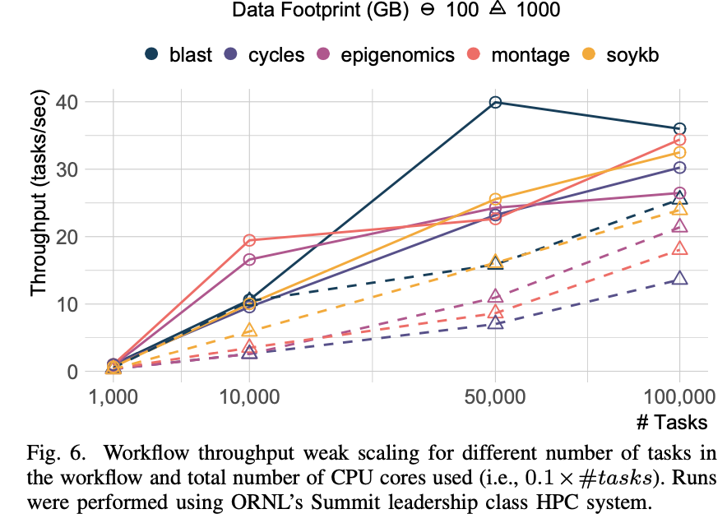
Performance: Workflows Benchmarking with WfBench
An effort towards evaluating the various Workflows Management Systems
WfBench is a software framework that offers
A “ground-truth” representation templates of prominent workflows from the community
A set of “translators” that may translate the templates into desired Workflow System
A configurable system “stressor” that may configure the resulting workflow tasks across the dimensions of processor / memory / IO intensive
Wfbench: Automated generation of scientific workflow benchmarks
T Coleman et al - 2022 IEEE/ACM PMBS (SC-W’22)

Slide 17
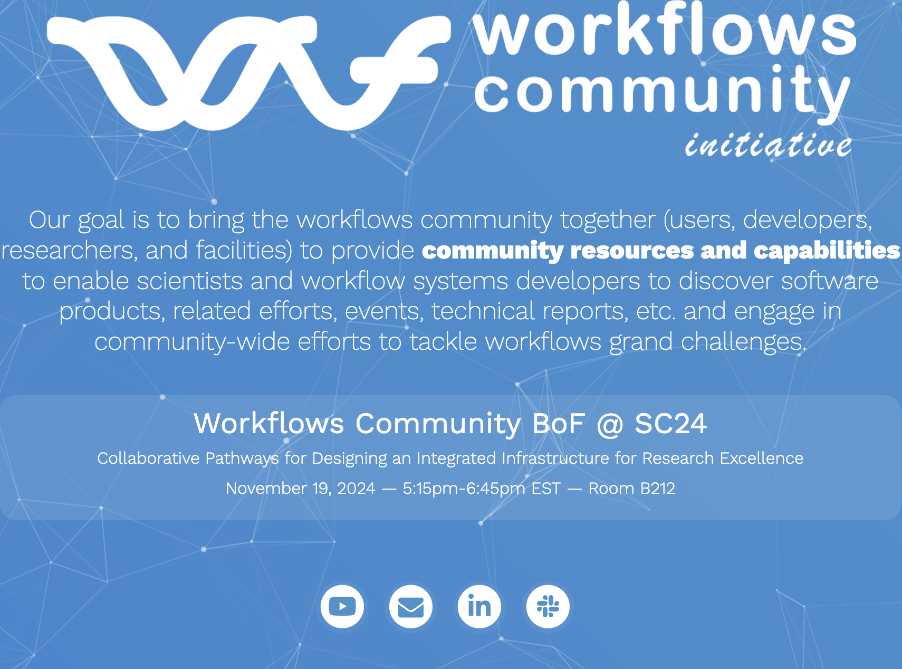
The People: Workflows Community Initiative
Over 200 registered members from 26 countries
Active discussions around topics like FAIR Workflows, Community engagement, Training, research and employment opportunities
On-line Summit held every year
BoFs at prominent conferences such as SC and eScience
web: workflows.community
slack: workflowscommunity.slack.com

Slide 18
Distributed HPC Workflows: State of the Art
A rough definition: Workflow that runs over a geographically & administratively distributed systems.
Largely an unconquered territory resulting in ad-hoc approaches
No workflow systems developed from scratch to handle Distributed Workflows
Human in the loop: manually move data to target location for postprocessing
Service based systems that expose their capabilities via REST APIs such as NERSC’s super-facilities API

Slide 19
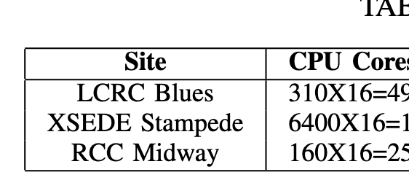
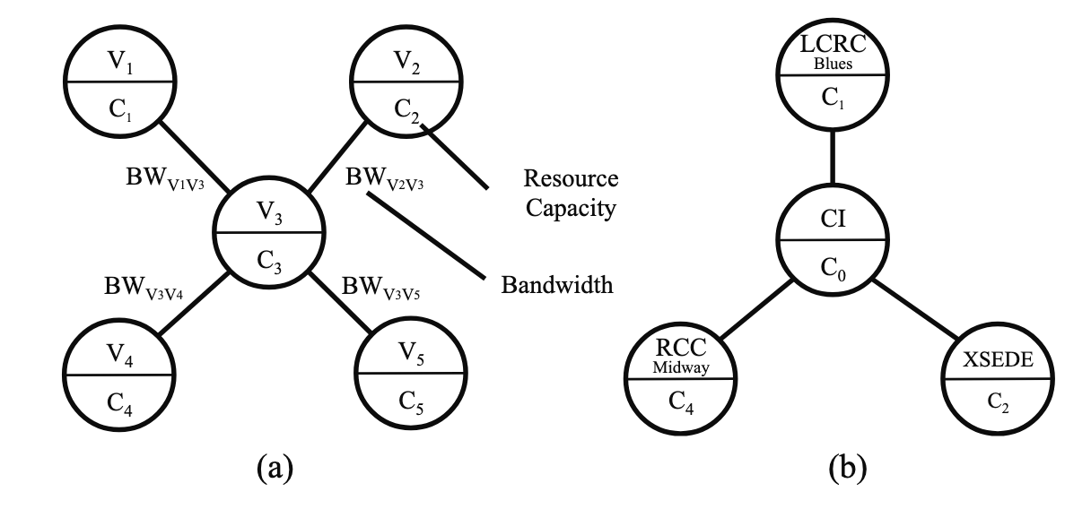
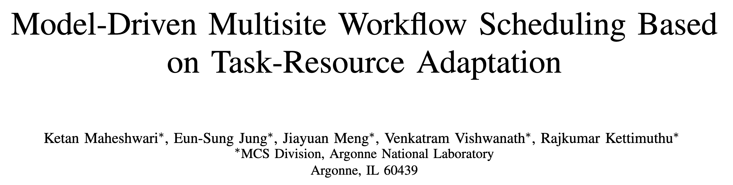
Distribute Workflows: Multisite Execution in Simpler Times
-- sites accessible via ssh key-based auth
-- Relatively simpler cybersecurity / firewalls
configurations
-- uniform scheduling interface

Slide 20
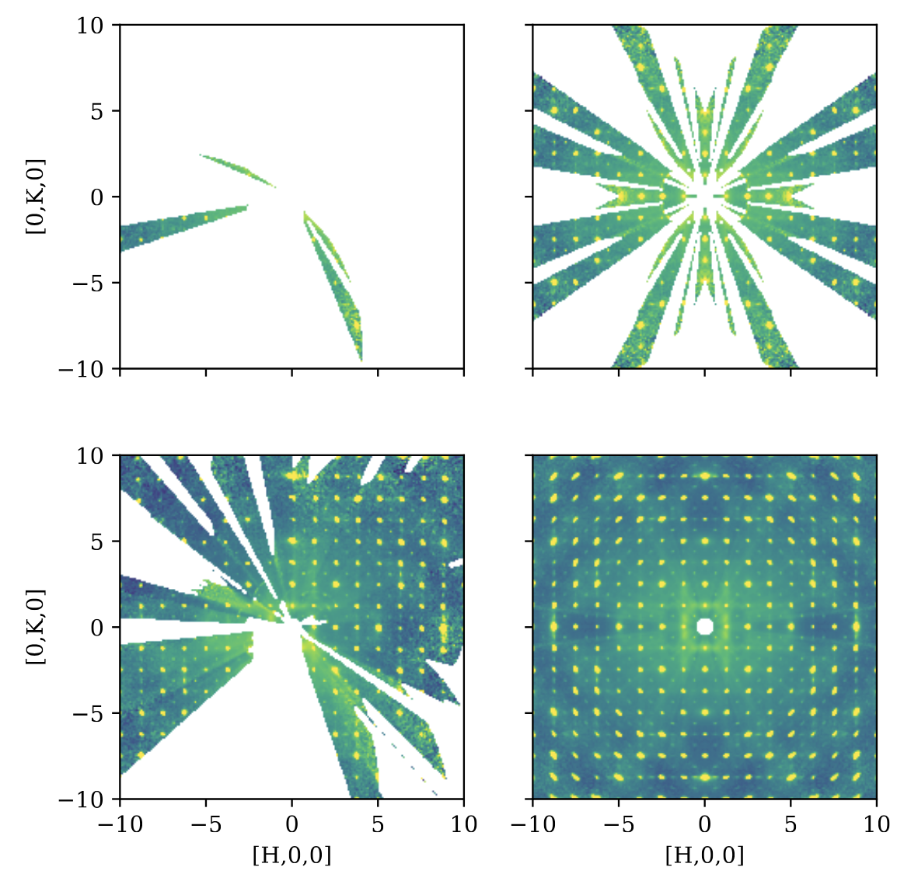
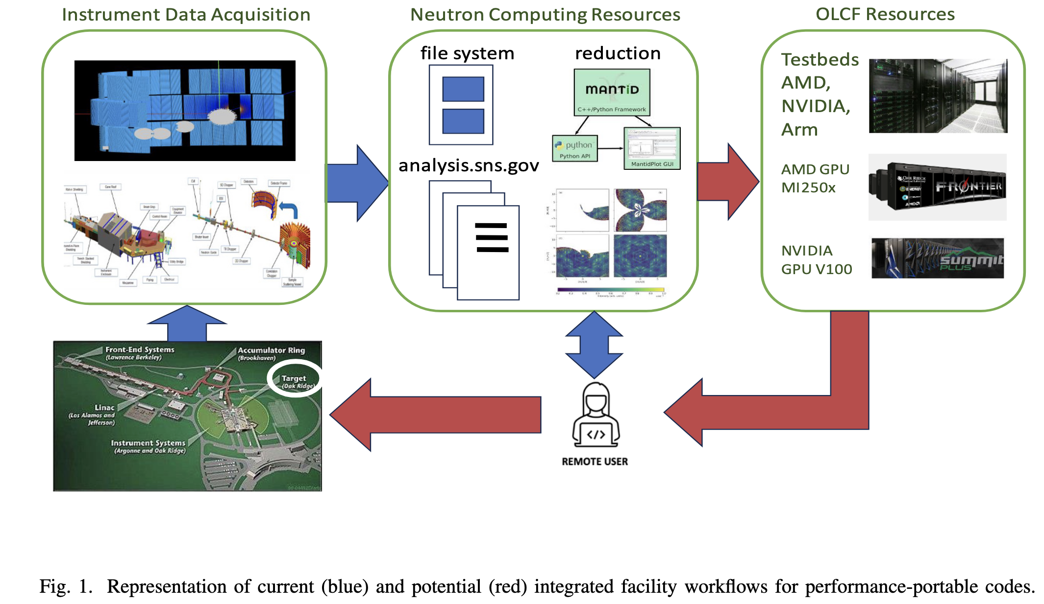
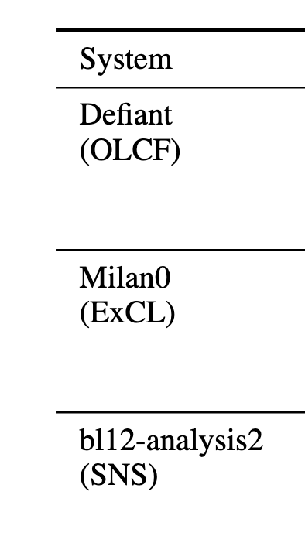
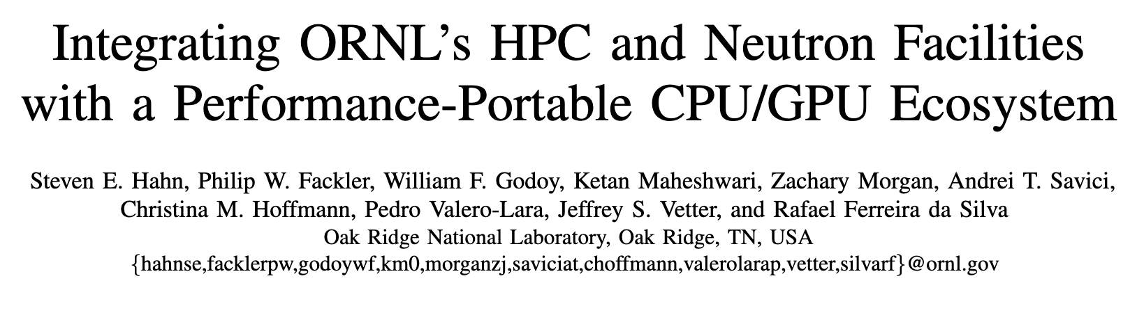
Distributed Workflows Efforts in Modern Times
Best paper at
the Workshop

Slide 21
Distributed HPC Workflows: Unification is the Biggest Opportunity
To bring about a culture of computing where-in a user would view a computer located in any of the DOE facility as easily accessible as the one on their desk or even in their pocket.
Workflows are poised to play a crucial role in the enablement of this vision.
SNS@ORNL
providing data
Analyses at NERSC
Analyses at ANL
Evaluation / Comparison at OLCF

Slide 22
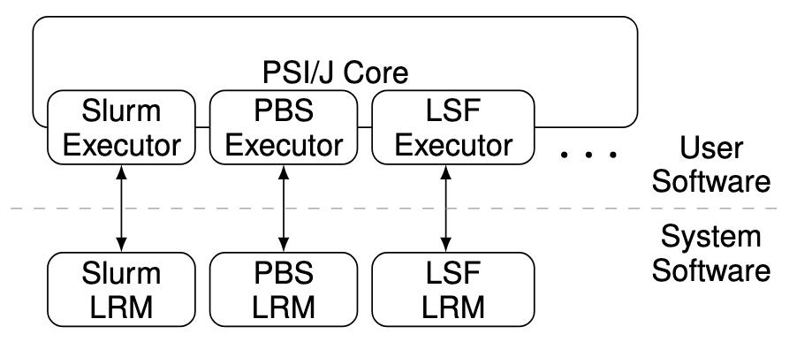
Distributed HPC Workflows Challenge - I : Heterogeneous Environments
Administered by different teams resulting in different access policies
Different resource managers: SLURM, PBS, Cobalt etc.
Different queuing policies, storage and directory structures
Opportunity: Develop an API that abstract away the heterogeneity of the underlying job schedulers
PSI/J: A portable interface for submitting, monitoring, and managing jobs
M Hategan-Marandiuc et al - 2023 IEEE 19th International Conference on e-Science

Slide 23
Distributed HPC Workflow Challenge - II : Cybersecurity
A many-folds increase in cyber threats
Firewalls and network security policies have become strict
Multi-factor authentication has become a norm
User agreements are much stricter
Institutional policies on sensitive data, export-controlled artefacts
Subtle bandwidth throttling over external networks
Opportunity: Steer the remote communications over known, secure and standard channels
Opportunity: Leverage shared data infrastructure such as message-based systems, share filesystems, distributed frameworks

Slide 24
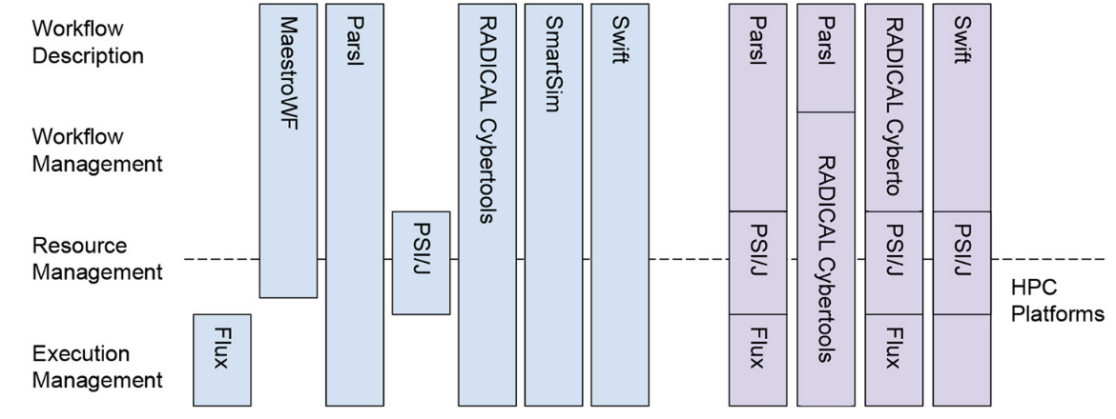
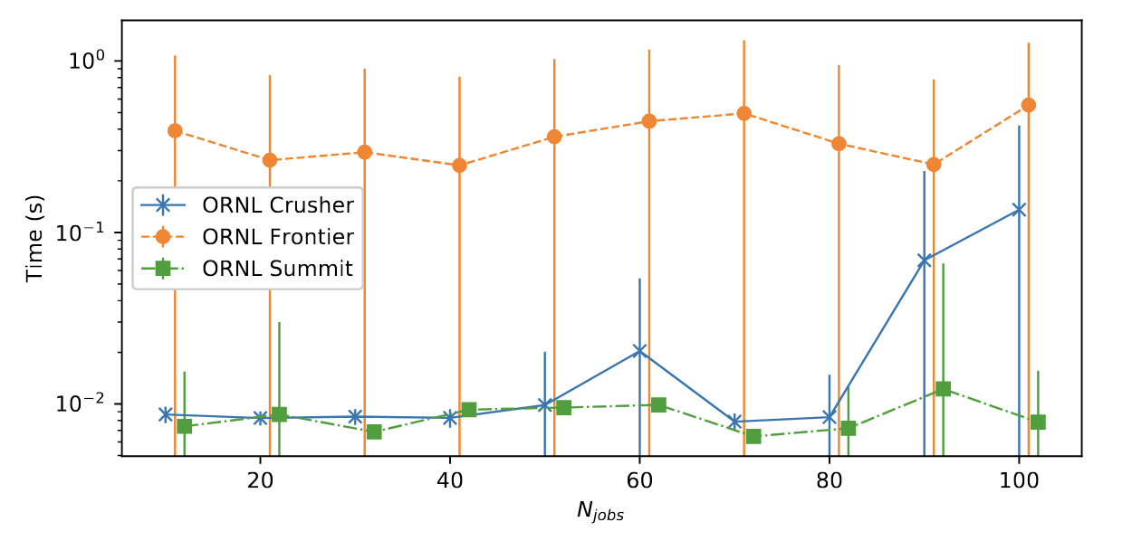
Future-I: ExaWorks: Workflows in the Exascale Era
The Exaworks Software Development
Kit is a curated collection of workflow technologies engineered following current best practices and specifically designed to work on HPC platforms.
ExaWorks software development kit: a robust and scalable collection of interoperable workflows technologies, M Turilli et al - Frontiers in High Performance Computing, 2024

Slide 25
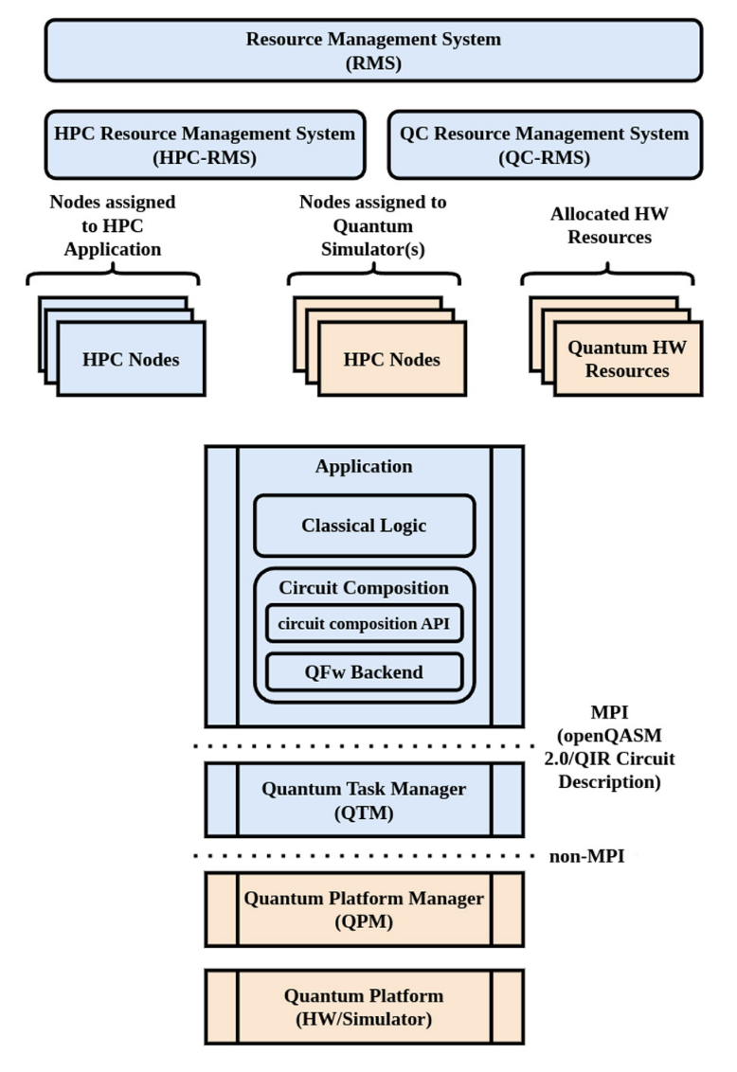
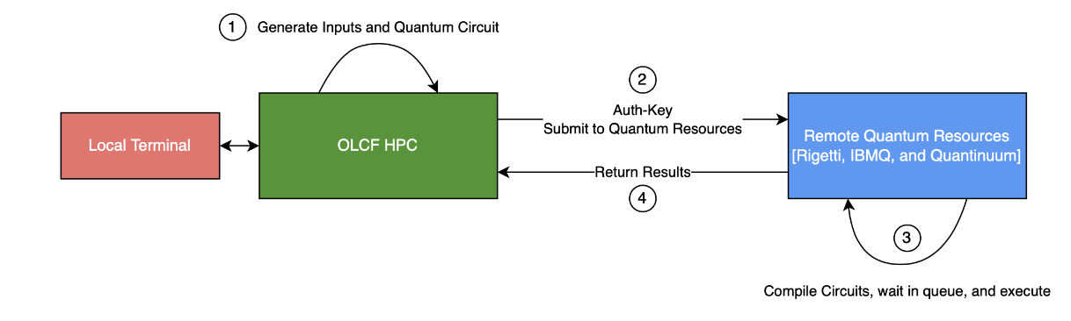
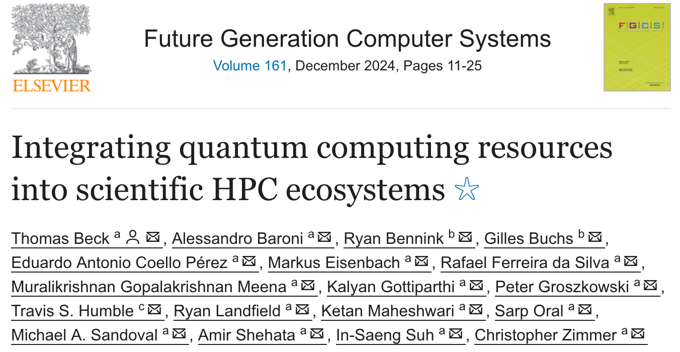
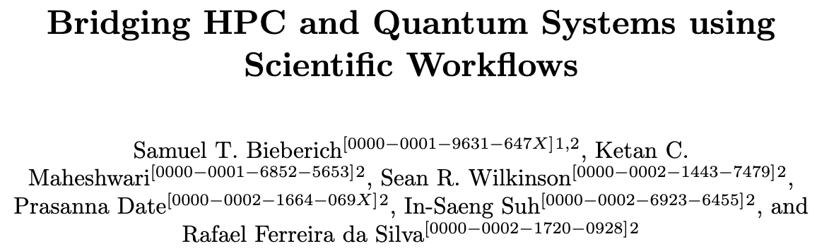
Future-II: Quantum-HPC Integration via Distributed Workflows
Quantum processors are
likely to supplement HPC a la
GPUs; resulting in an ecosystem
where coordination and
cooperation among traditional
and quantum processes will be
required.

Slide 26
Summary
With a 25+ years of research and development history, Scientific Workflows continue to be an important tool for researchers
Wide adoption in the community though the distributed workflows remain to be a challenge
Newer paradigms, methods and solutions seem to be only fueling the trend for workflows feature demands and development as seen by the increasing community interest

Slide 27
Thank You for your time! Questions?
maheshwarikc@ornl.gov | github.com/ketancmaheshwari/uci-ucr

Slide 28
Extra Slide
Define and capture a scientific campaign
A live, executable unit of communication and documentation
Automation of complex computational stages that may require different environments: tedious to perform manually
Repeatable with minimal errors and mistakes
May run on multiple platforms providing flexibility in scale and deployments
Leverage parallelism and concurrency offered by the computational platform

